Slide 1

Introducing Classes Part 2 Java - The Complete Reference Herbert Schildt Chapter 6

Slide 2
Outline
Constructors
Default Constructor
Parameterized Constructors
The this keyword
Instance Variable Hiding
Garbage Collection
The finalize() method
A Stack Class

Slide 3
Constructors

Slide 4
Constructors
A constructor is a special method that initializes an object immediately upon creation.
It has the same name as the class in which it resides and is syntactically similar to a method.
Once defined, the constructor is automatically called when the object is created, before the new operator completes.
Constructors do not have any return type, not even void.
The implicit return type of a class’ constructor is the class type itself.
It is the constructor’s job to initialize the internal state of an object so that the code creating an instance will have a fully initialized, usable object immediately.

Slide 5
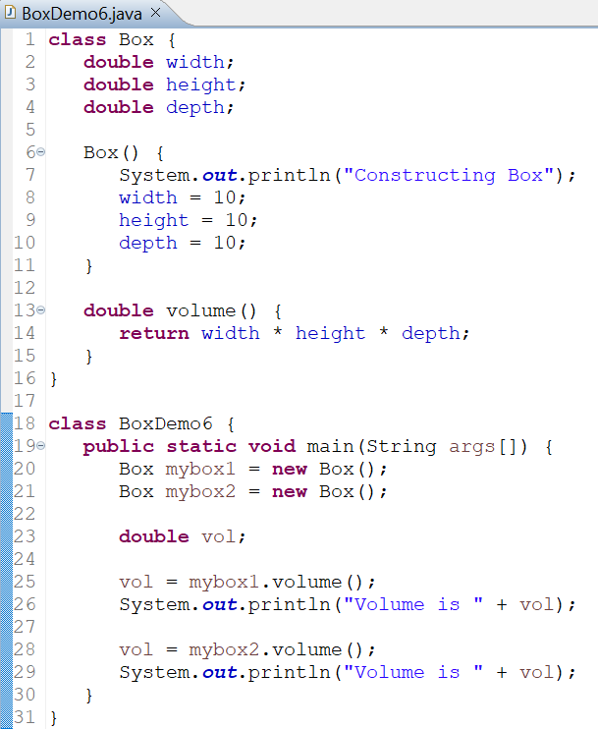
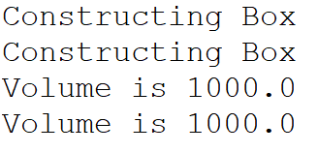
Constructors
OUTPUT

Slide 6
Default Constructor
When we do not explicitly define a constructor for a class, Java creates a default constructor for the class.
The default constructor automatically initializes all instance variables to their default values, which are as follows:
The default constructor is often sufficient for simple classes, but it usually won’t do for more sophisticated ones.
Once you define your own constructor, the default constructor is no longer used.
Numeric Types | Reference Types | Boolean
zero | null | false

Slide 7
Parameterized Constructors

Slide 8
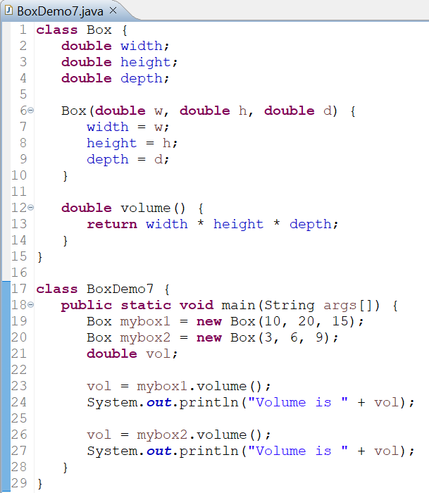
Parameterized Constructors
Parameters can be passed to constructors to initialize each object separately.
Parameterized constructors are very common in Java programs.

Slide 9
The this keyword

Slide 10
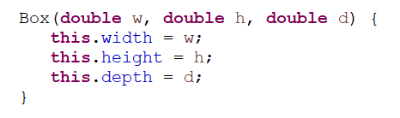
The this keyword
Sometimes a method will need to refer to the object that invoked it.
To allow this, Java defines the this keyword.
this can be used inside any method to refer to the current object.
this is always a reference to the object on which the method was invoked.
We can use this anywhere a reference to an object of the current class’ type is permitted.
In the code, the use of this is redundant, but perfectly correct.

Slide 11
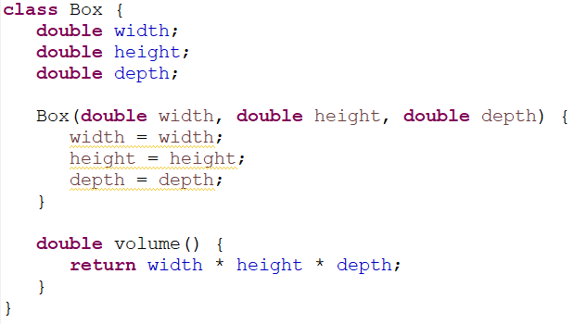
Instance Variable Hiding
In Java, it is illegal to declare two local variables with the same name inside the same or enclosing scopes.
However, we can have local variables, including formal parameters to methods, which overlap with the names of the class’ instance variables.
When a local variable has the same name as an instance variable, the local variable hides the instance variable.
In the code, width refers to the formal parameter, hiding the instance variable width.
So, Java compiler provides warning.

Slide 12
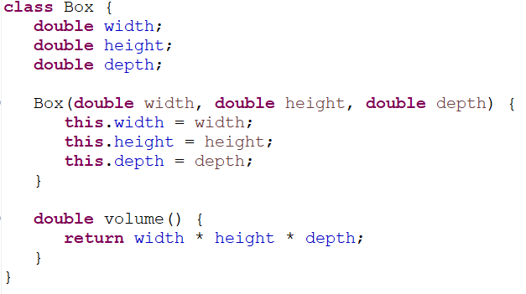
Solution to Instance Variable Hiding
One solution is to use different names.
Another solution is to use this keyword.
Because this lets us refer directly to the object, we can use it to resolve any namespace collisions that might occur between instance variables and local variables.
In the code, width refers to the formal parameter and this.width refers to the instance variable.
Some programmers prefer to use different names, others prefer using this keyword.

Slide 13
Garbage Collection

Slide 14
Garbage Collection
In Java, objects are dynamically allocated by using the new operator.
So, how objects are destroyed, and their memory released for later allocation?
In C, free() function is used. In C++, delete operator is used.
Java uses a mechanism called Garbage Collection to handle deallocation automatically for programmers.
When no references to an object exist, that object is assumed to be no longer needed, and the memory occupied by the object can be reclaimed.
Garbage Collector only runs sporadically (if at all) during the execution of your program.

Slide 15
Garbage Collection
The JVM monitors the program's memory usage and runs the garbage collector when certain conditions are met.
It can depend on the following factors:
JVM implementation
Available system resources
Amount of memory allocated by the program
Size of the heap
The age of objects
The amount of garbage present in memory
Advantage: It remove the burden of releasing memory from programmers.

Slide 16
The finalize() method

Slide 17
The finalize() Method
Sometimes an object will need to perform some action when it is destroyed.
Example: Releasing non-Java resource such as a file handle or database connections.
Java provides a mechanism called finalization.
We simply need to define the finalize() method for the class.
The Java Garbage Collection calls the finalize() method whenever it is about to recycle an object of that class.
Inside the finalize() method, we need to specify those actions that must be performed before an object is destroyed.

Slide 18

The finalize() Method
General form:
The finalize() method is somewhat similar to the destructor function in C++.
As of Java 9, the finalize() method has been deprecated.
Better mechanisms for resource management, such as try-with-resources and AutoCloseable interface, should be used.

Slide 19
A Stack Class

Slide 20
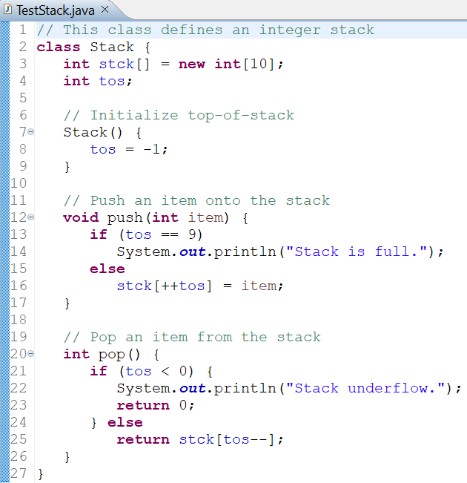
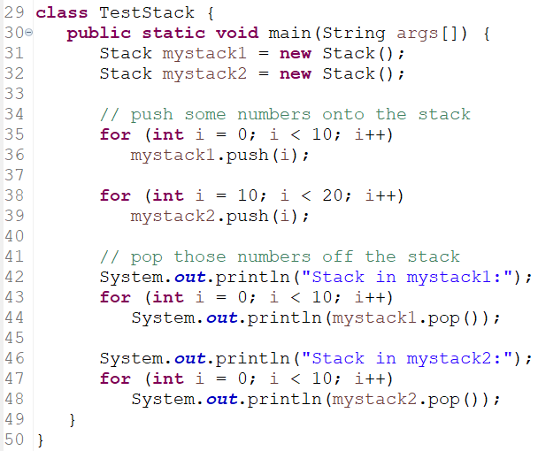
A Stack Class

Slide 21
A Stack Class: Analysis
A stack stores data using first-in, last-out (LIFO) ordering.
Stacks are controlled through two operations traditionally called push and pop.
As we can see in the code, the Stack class encapsulates the entire stack mechanism and its associated data.
We can use the class through its methods without having to worry about the details of its implementation or how the data is actually managed within the class.
In a sense, a class is like a “data engine.”
No knowledge of what goes on inside the engine is required to use the engine through its controls.

Slide 22
A Stack Class: Analysis
Since access to the stack is through push() and pop(), the fact that the stack is held in an array is actually not relevant to using the stack.
For example, the stack could be held in a more complicated data structure, such as a linked list, yet the interface defined by push( ) and pop( ) would remain the same.
Last point: It is possible for the array that holds the stack, stck, to be altered by code outside of the Stack class.
This leaves Stack open to misuse or mischief.
We can use Access Modifiers to solve this issue.

